Slide 1

Functions of Random Variables, or Deriving Probability Models
Massachusetts Institute of Technology
September 20, 2017
Richard C. Larson

Slide 2
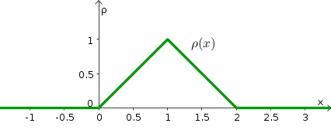

Functions of Random Variables
Y=3X-2Z

Slide 3
4 Steps to Happiness:
1. Define the Random Variables
2. Identify the joint sample space
3. Determine the probability law over the sample space
4. Carefully work in the sample space to answer any question of interest

Slide 4
4 Steps: Functions of R.V.s
1. Define the Random Variables
2. Identify the joint sample space
3. Determine the probability law over the sample space
4. Carefully work in the sample space to answer any question of interest
4a. Derive the CDF of the R.V. of interest, working
in the original sample space whose probability
law you know
4b Take the derivative to obtain the desired PDF

Slide 5
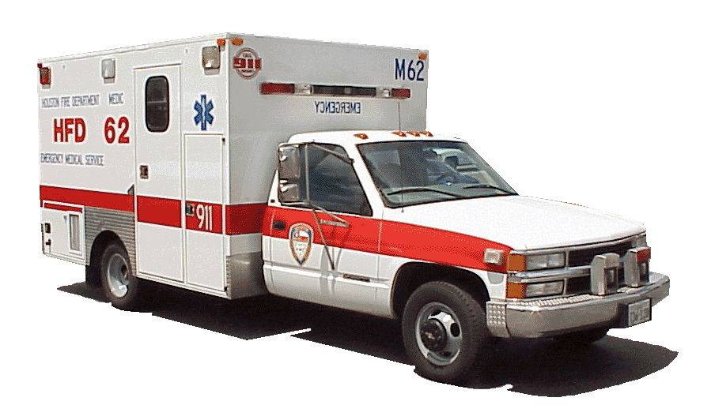
http://www.ci.houston.tx.us/hfd/general/images/ambulance.gif

Slide 6


Slide 7
Response Distance of an Ambulance
0
1
1. R.V.;s
  X₁ = location of the accident
  X₂ = location of the ambulance
  D = response distance = | X₁ - X₂ |
2. Joint sample space is unit square in X₁ X₂ plane
3. PDF over square is uniform
accident
ambulance

Slide 8
x₂
1
0
1
x₁

Slide 9
x₂
Event {D<y}
x₂ = x₁ + y
1
x₂ > x₁
x₂ = x₁ - y
y
x₂ < x₁
0
y
1
x₁

Slide 10
x₂
Event {D<y}
x₂ = x₁ + y
x₂ > x₁
x₂ = x₁ - y
y
x₂ < x₁
y
x₁
4.a F_{D}(y) = P{D<y} = 1 - (1-y)², 0<y<1
4.b f_{D}(y) = 2(1-y), 0<y<1.

Slide 11
f_{D}(y) = 2(1-y)
2
0
1
y
Mean = 1/3

Slide 12
In previous problem, E[D] = 1/3
What if we fix the location of the ambulance at X₂ = 1/2?
fixed location
ambulance
0
1/2
1
accident

Slide 13
fixed location
ambulance
0
1/2
1
accident
f_{D}(y)
2
0
1/2
y
E[D] = 1/4, a 25% reduction

Slide 14
Rectangular Response Area
y
Y_{o}
(x₂, y₂)
(x₁, y₁)
X_{o}
x
D = |X₁ - X₂| + |Y₁ - Y₂|

Slide 15
Scaling to Get Expected
Travel Distance
Y_{o}
(x₂, y₂)
(x₁, y₁)
D = |X₁ - X₂| + |Y₁ - Y₂|
E[D] = E[|X₁ - X₂| + |Y₁ - Y₂|]
E[D] = (1/3)[X_{o} + Y_{o}]
X_{o}
x

Slide 16
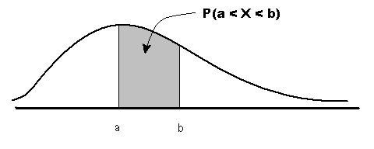
More Examples of Functions of Random Variables

Slide 17
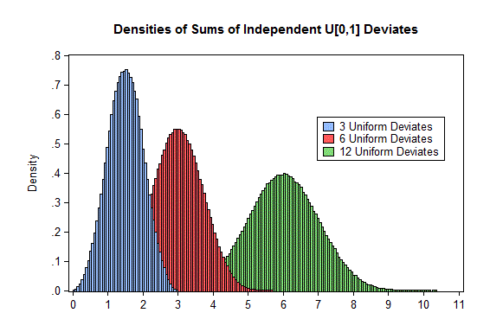
Sums of Random Variables

Slide 18
WHAT ABOUT
Y = X₁ + X₂
Where X₁ and X₂ are iid uniform over [0, 1]?
Seek F_{Y}(y) = Pr{Y < y}
= Pr{X₁ + X₂ < y}
= Pr{X₂ < y – X₁}

Slide 19
x₂
1
y
0
y
1
x₁
Event {X₂ < y – X₁}
Pr{X₂ < y – X₁} = y²/2, for what range of y?

Slide 20
x₂
1
(2 – y)
(y – 1)
Event {X₂ < y – X₁}
For y > 1,
0
y
1
(y – 1)
x₁
For 1 < y < 2: Pr{X₂ < y – X₁} = 1 - (1/2) [1 – (y-1)]² =
= 1 - (1/2) [2 – y]² = 1 – (1/2)(4 - 4y+ y²)
= 1 – 2 + 2y – y²/2 = – 1 + 2y – y²/2

Slide 21
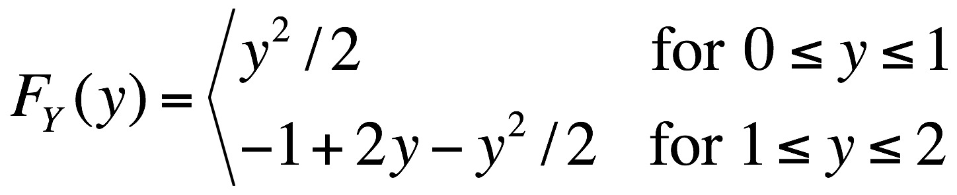
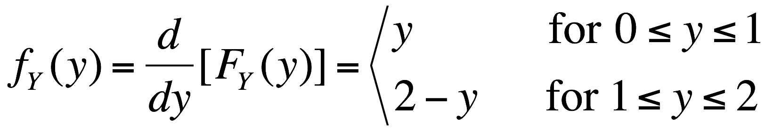
In Summary, we have
F_{Y}(y) = Pr{Y < y}
= Pr{X₁ + X₂ < y}
= Pr{X₂ < y – X₁}
Look back at a dy geometrical derivation!

Slide 22
Central Limit Theorem Demo
Thanks to Prof. Dan Frey! :)
ESD.86

Slide 23
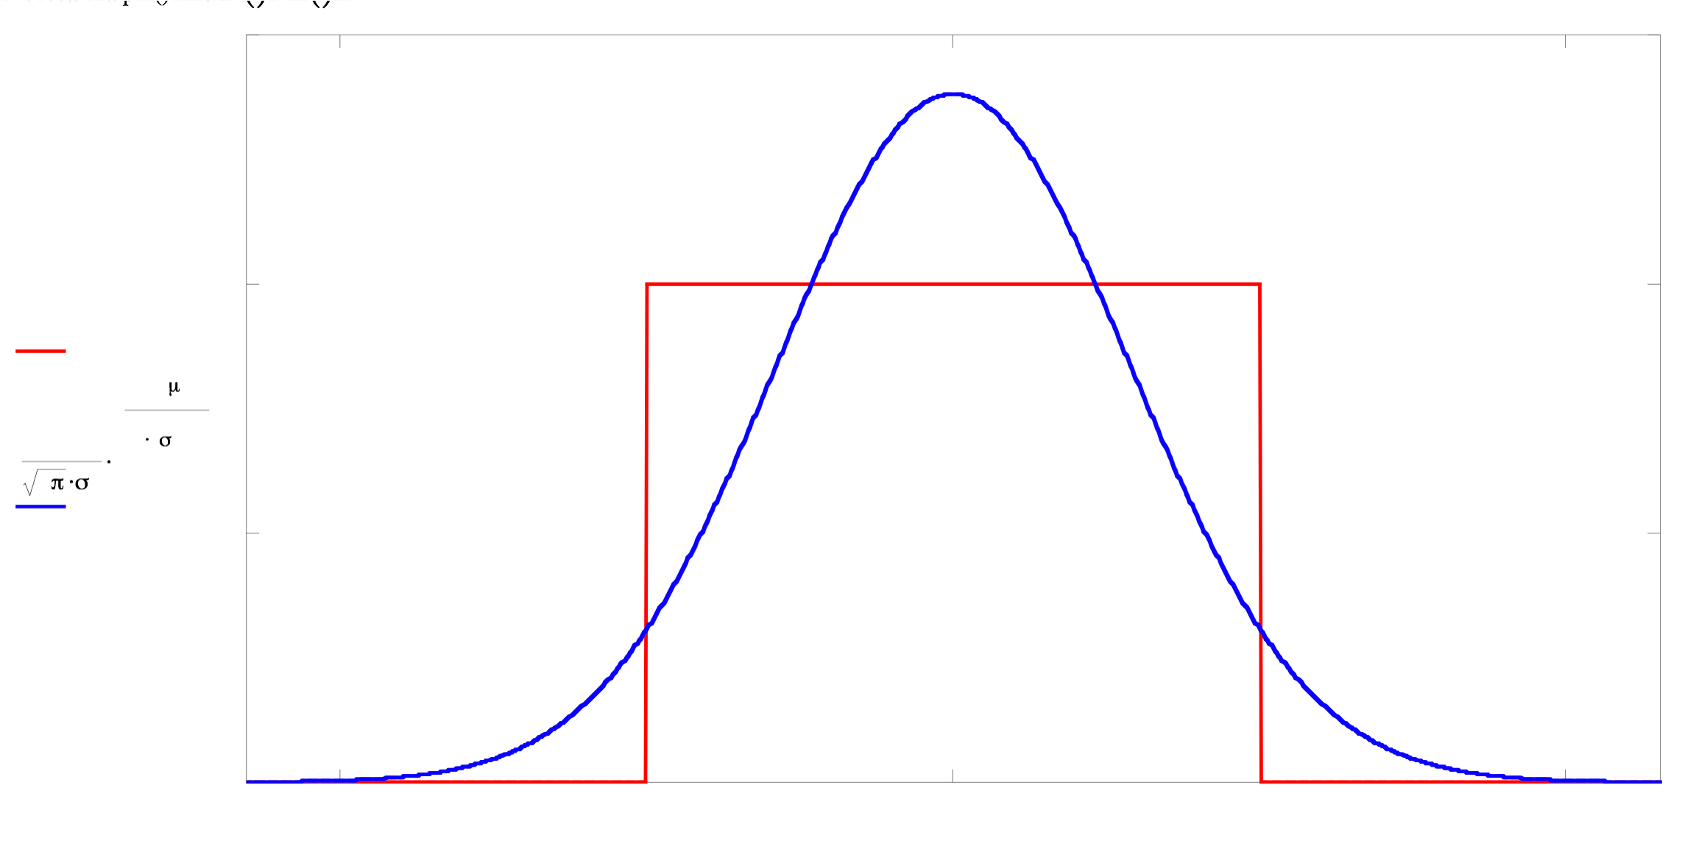
One Uniformly Distributed Random Variable

Slide 24
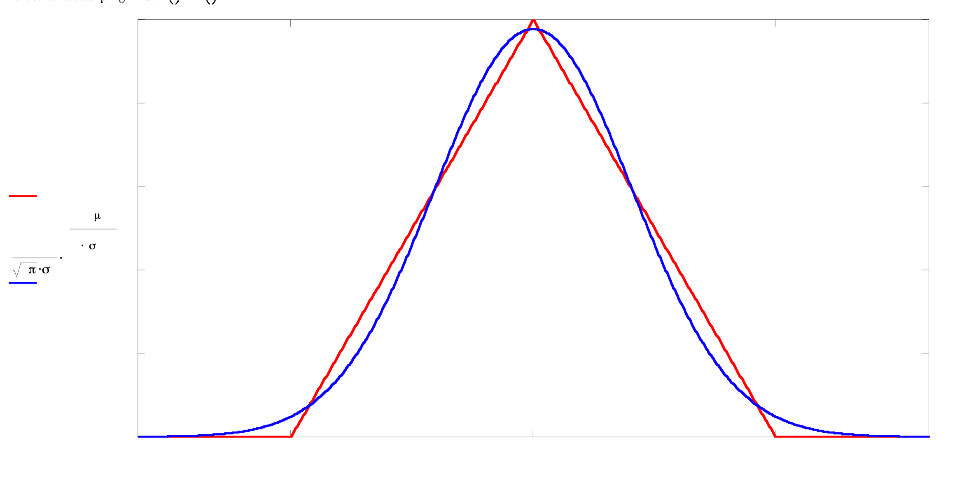
Sum of 2 iid Uniformly Distributed Random Variables

Slide 25
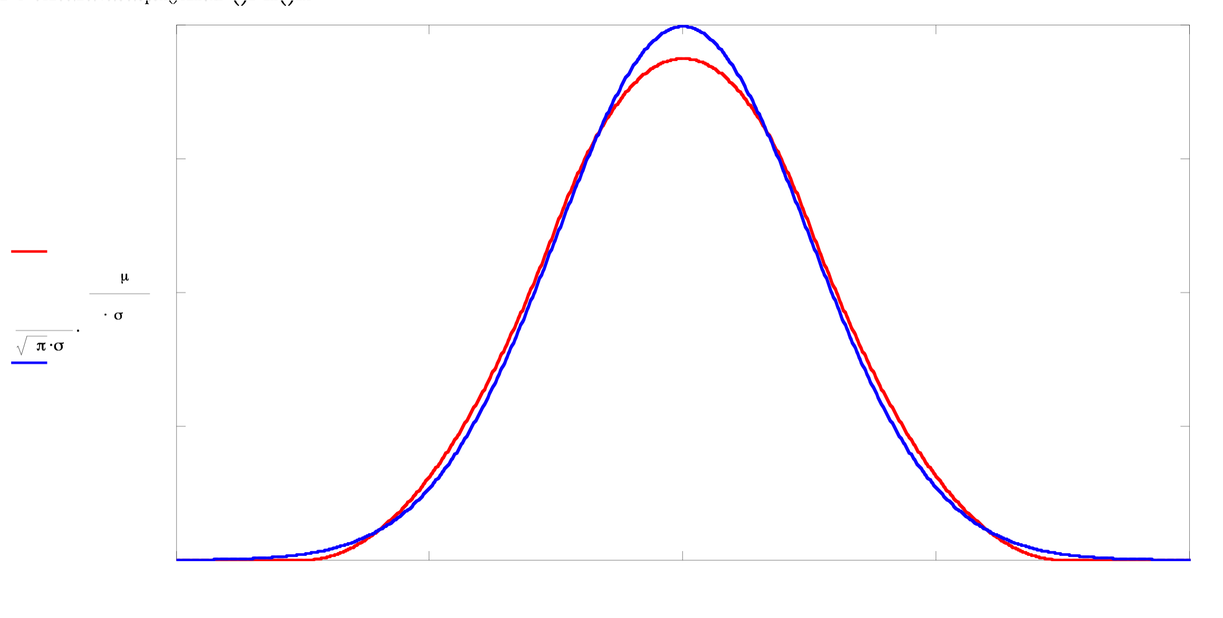
Sum of 3 iid Uniformly Distributed Random Variables

Slide 26
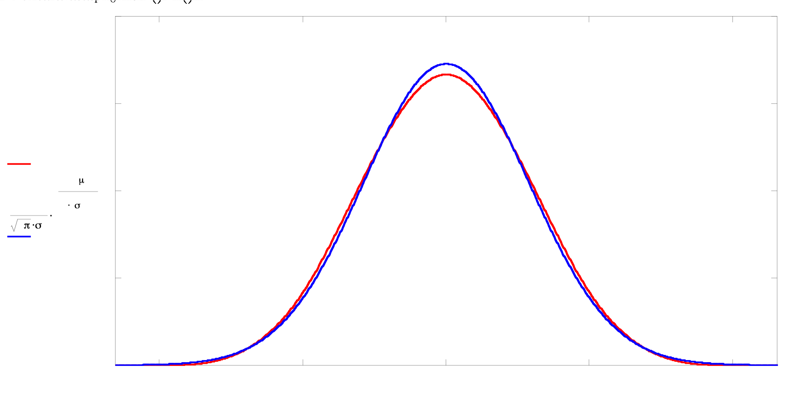
Sum of 4 iid Uniformly Distributed Random Variables

Slide 27
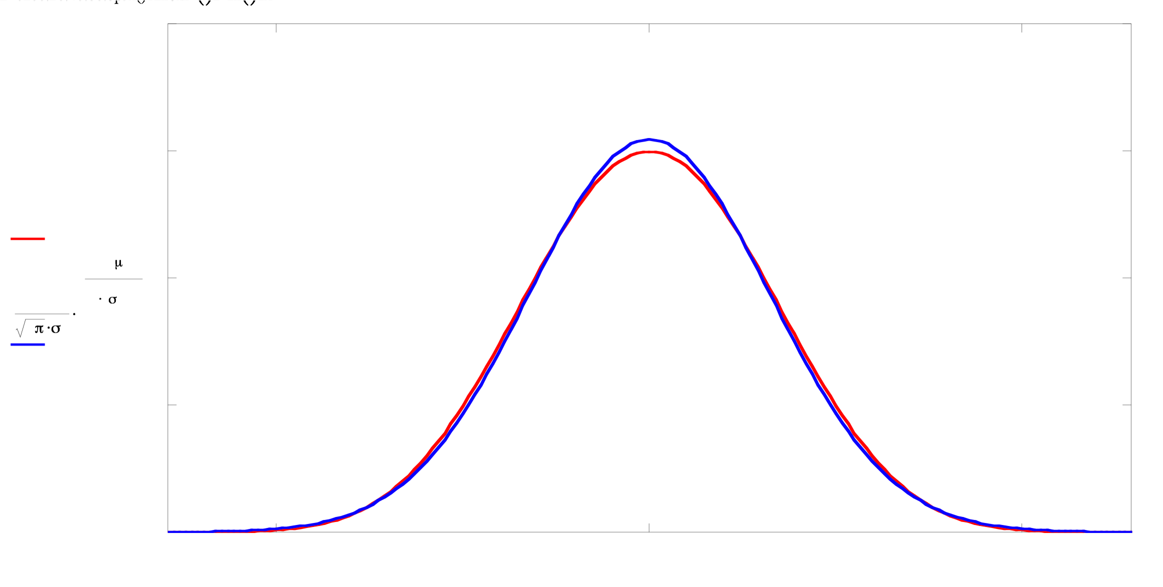
Sum of 5 iid Uniformly Distributed Random Variables

Slide 28
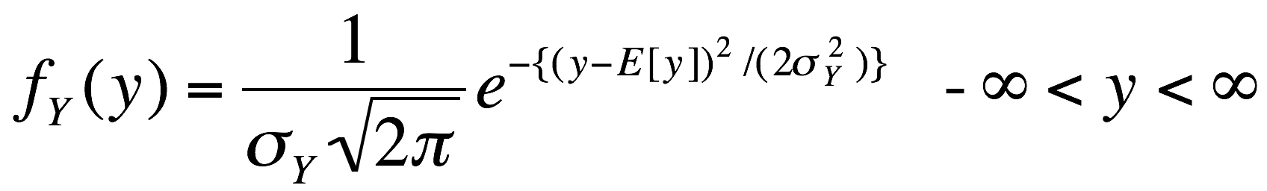
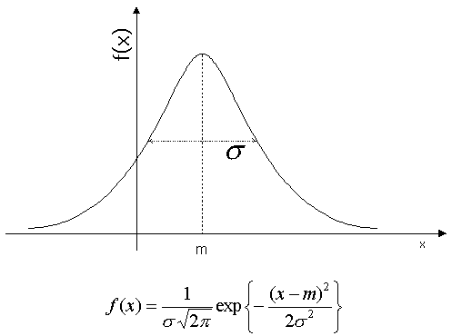
The Gaussian or Normal PDF
http://coding.yonsei.ac.kr/images/f10.gif

Slide 29
More Examples of Functions of Random Variables

Slide 30
Define the Random Variables
Y=MIN{X₁, X₂}, where X₁ and X₂ are iid uniform over [0,1]
Identify the joint sample space
x₂
1
0
1
x₁
Determine the probability law over the sample space - uniform

Slide 31
Carefully work in the sample space to answer
any question of interest.
F_{Y}(y) = P{Y<y}=
P{MIN[X₁, X₂ ]<y}
=1-(1-y)²
f_{Y}(y)=d/dy [F_{Y}(y)]
f_{Y}(y)=2(1-y), 0<y<1
x₂
y
0
y
x₁
4a. Derive the CDF of the R.V. of interest, working
in the original sample space whose probability
law you know
4b Take the derivative to obtain the desired PDF

Slide 32
Now suppose
Y=MIN{X₁, X₂ ,X₃, ...X_{N}}, where X_{i} are iid uniform over [0,1]
F_{Y}(y) = P{Y<y} = 1- P{Y>y}
F_{Y}(y) = 1- (1-y)^{N}
f_{Y}(y) = (d/dy) F_{Y}(y) = N(1-y)^{N-1;} N= 2, 3, …
0<y<1
1-y
0
y
1

Slide 33
Now suppose
Y=MAX{X₁, X₂ ,X₃, ...X_{N}}, where X_{i} are iid uniform over [0,1]
F_{Y}(y) = P{Y<y} = y^{N} Why?
f_{Y}(y) = Ny^{N-1} N= 2, 3,…; 0<y<1
OK, so now we can do Max and Min.
Question: How would things change if the
original pdf‘s were not uniform?

Slide 34
Min, Max. Deriving a Joint PDF
Suppose X₁ and X₂ are i.i.d. uniformly distributed over [0, 1]. They could, for instance, be the locations of 2 police cars.
We seek to derive the joint pdf of Y and Z, where
Y=Min(X₁, X₂)
Z=Max(X₁, X₂)
That is, we seek
f_{Y,Z}(y,z)dydz=P{y<Y<y+dy,z<Z<z+dz}

Slide 35

Four Steps to Happiness
Define the random variables
Y=Min(X₁, X₂)
Z=Max(X₁, X₂)
Define the joint sample space:
  Unit square in positive quadrant
Identify the probability measure over
the joint sample space: Uniform.
Work within the sample space to answer
any questions of interest.
http://www.schwimmerlegal.com/smiley.jpg

Slide 36
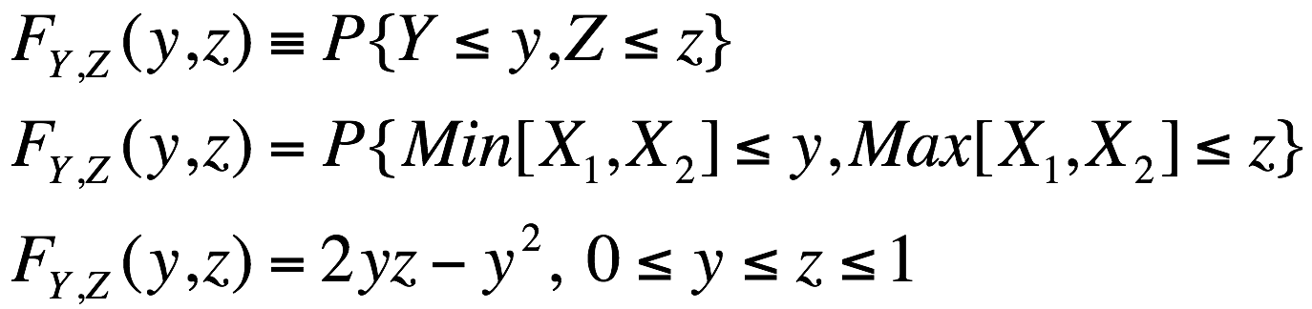
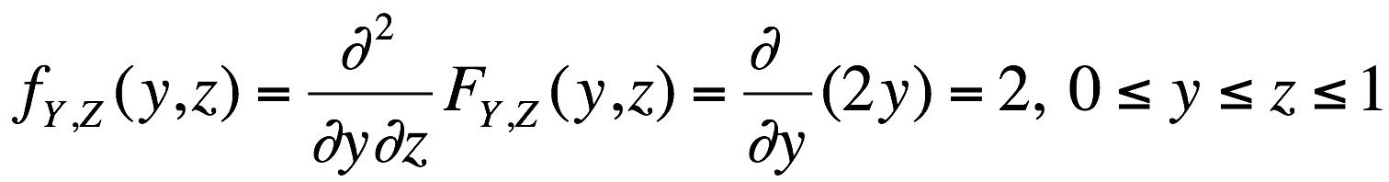
Work within the sample space
x₂
Use CDF
1
z
y
y
z
1
x₁

Slide 37
Work within the sample space
z
Height of pdf = 2
1
What do we do if we do
not have the simple square
symmetry of this problem?
What do we do if the pdf is
not uniform?
0
1
y

Slide 38
Ratio of Manhattan to Euclidean Distance Metrics
1. Define R.V.’s
  D₁ = |X₁ - X₂| + |Y₁ - Y₂|
  D₂ = (X₁ - X₂)² + (Y₁ - Y₂)²
  Ratio = R = D₁ / D₂
  Ψ = angle of directions of travel wrt straight line connecting (X₁ , Y₁) & (X₂ , Y₂)

Slide 39
(X₁, Y₁)
(X₂, Y₂)
Directions of Travel

Slide 40
(X₁, Y₁)
(X₂, Y₂)
One possible minimum distance path
Directions of Travel

Slide 41
sin(ψ)D₂
Cos(ψ)D₂
Ψ=ψ
(X₁, Y₁)
(X₂, Y₂)
One possible minimum distance path
Directions of Travel

Slide 42
(R|Ψ) = cos Ψ + sin Ψ = 2 ^{1/2} cos(Ψ - π/4)
2. Identify Sample Space
3. Probability Law over Sample Space:
Invoke isotropy implying uniformity of angle
0
π/2
ψ

Slide 43
f_{Ψ}(ψ)
2/ π
0
π/2
ψ

Slide 44
4. Find CDF
F_{R}(r) = P{R < r} = P{2^{1/2} cos(Ψ-π/4) < r}
F_{R}(r) = P{R < r} = P{cos(Ψ-π/4) < r/ 2^{1/2} }

Slide 45
g(Ψ)
1
cos(Ψ-π/4)
r/2^{1/2}
1/2^{1/2}
0
π/4
π/2
Ψ

Slide 46
g(Ψ)
1
cos(Ψ-π/4)
r/2^{1/2}
1/2^{1/2}
0
π/4
π/2
Ψ
-cos ⁻¹ (r/2^{1/2}) + π/4
cos ⁻¹ (r/2^{1/2}) + π/4

Slide 47
1
Probability of 'red event' = 2*(2/π)*{-cos ⁻¹ (r/2^{1/2}) + π/4}
pdf for Ψ
2/π
0
π/4
π/2
Ψ
-cos ⁻¹ (r/2^{1/2}) + π/4
cos ⁻¹ (r/2^{1/2}) + π/4

Slide 48
And finally...
After all the computing is done, we find:
F_{R}(r) = 1 - (4/π)cos ⁻¹ (r/2^{1/2}), 1< r <2^{1/2}
f_{R}(r) = d[F_{R}(r) ]/dr = (4/π) {1/(2 - r²)^{1/2} }
1< r <2^{1/2}
Median R = 1.306
E[R] = 4/π = 1.273
σ_{R}/E[R] = 0.098, implies very robust

